Slide 1
Crow foot
Entity Relationship (ER) Modeling

Slide 2
The ERD represents the conceptual database as viewed by the end user.
Content
Entity
Attribute
Relationship

Slide 3
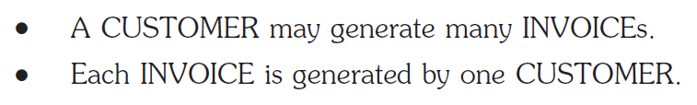
Relationship & Participant (Recap)
Relationship
-- An association between entities
Participant
-- Entity participates in a relationship
Each relationship is identified by a name that describes the relationship.

Slide 4
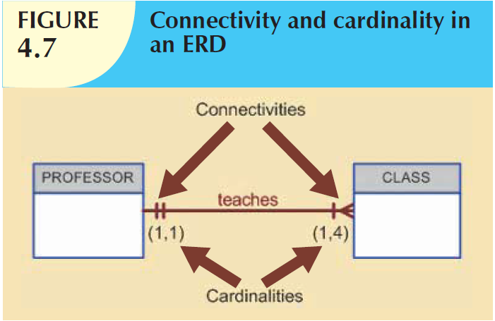
Connectivity & Cardinality(Recap)
Cardinality expresses the minimum and maximum number of entity occurrences associated with one occurrence of the related entity.

Slide 5
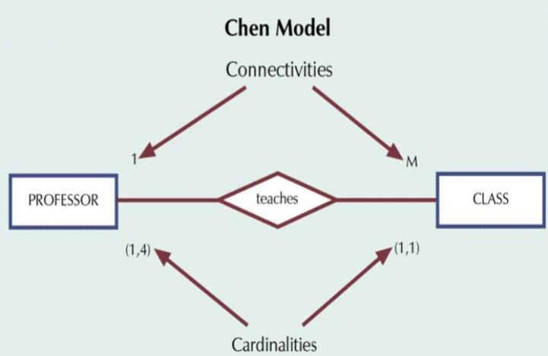

Slide 6
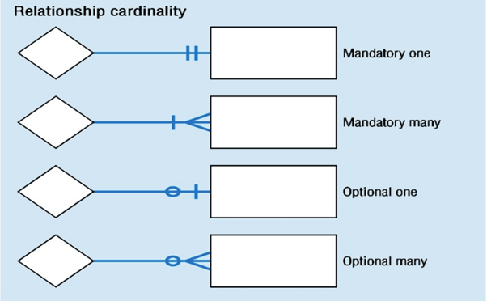
Mapping CARDINALITY (CONT...)

Slide 7
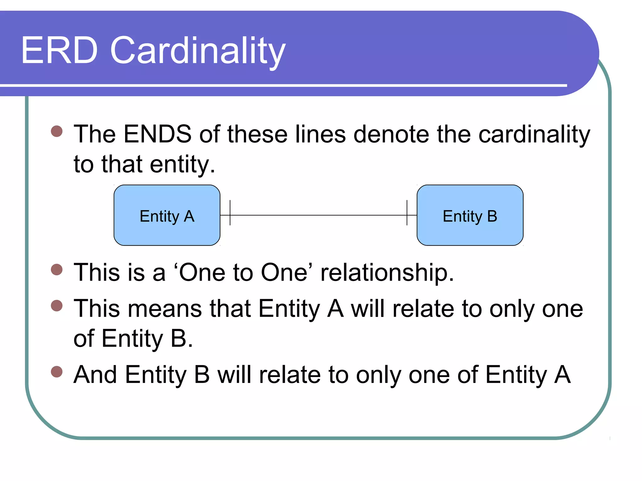
One-to-One Relationship

Slide 8
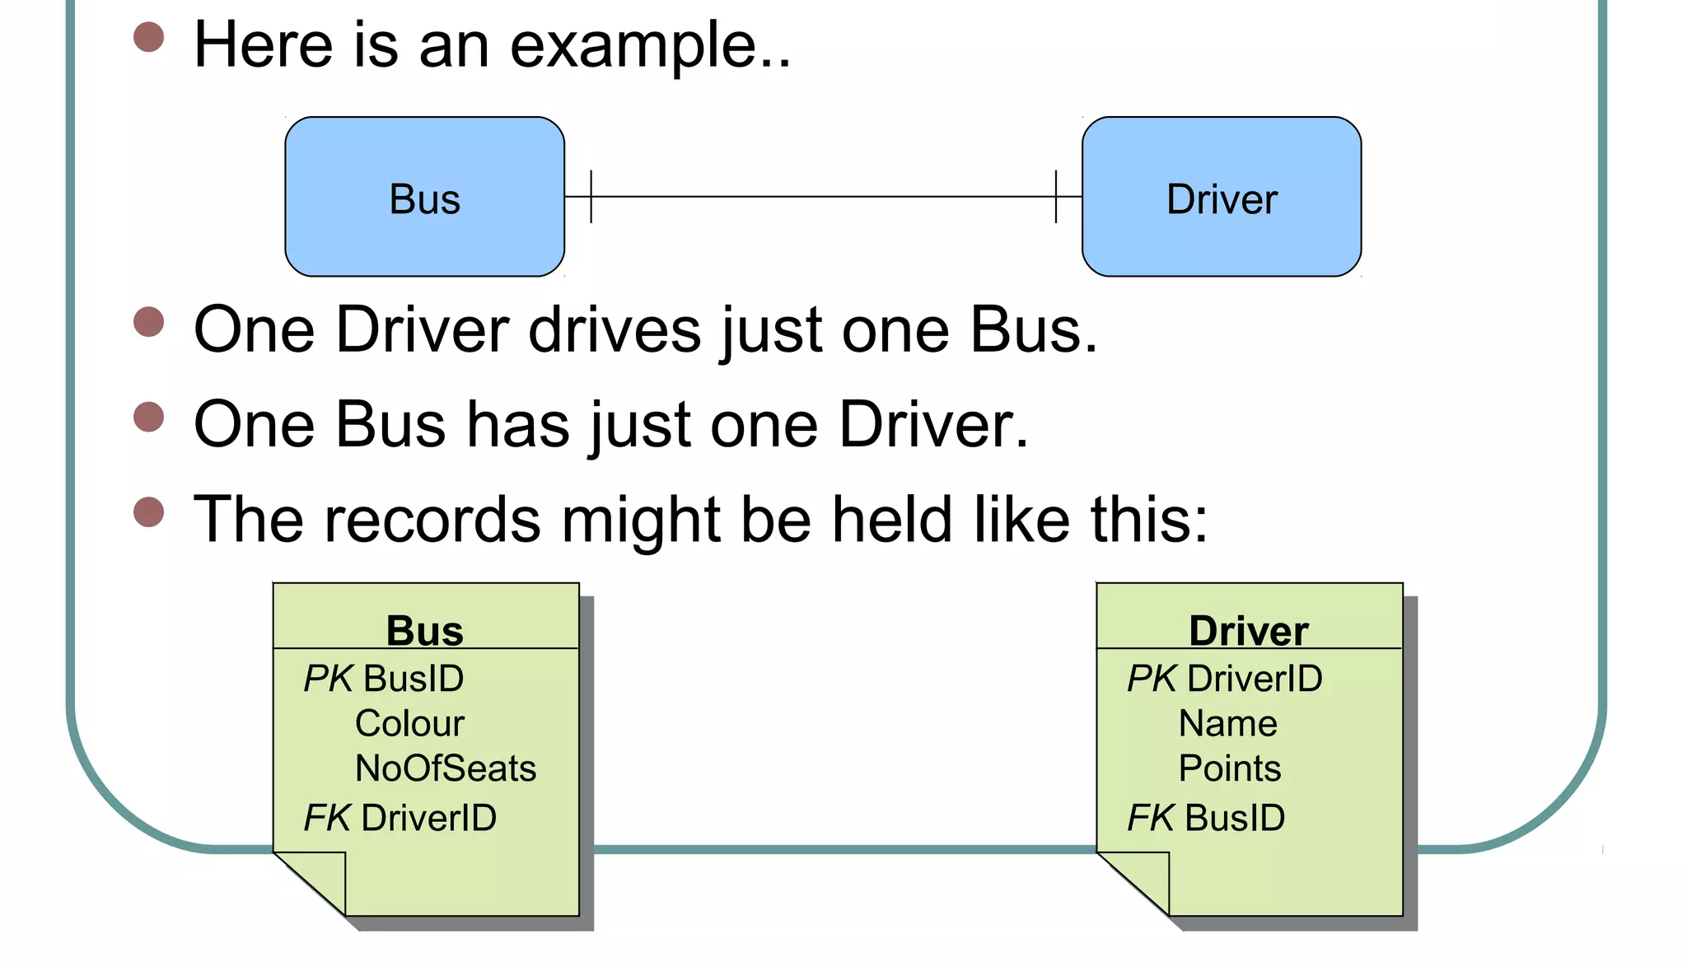
Example

Slide 9
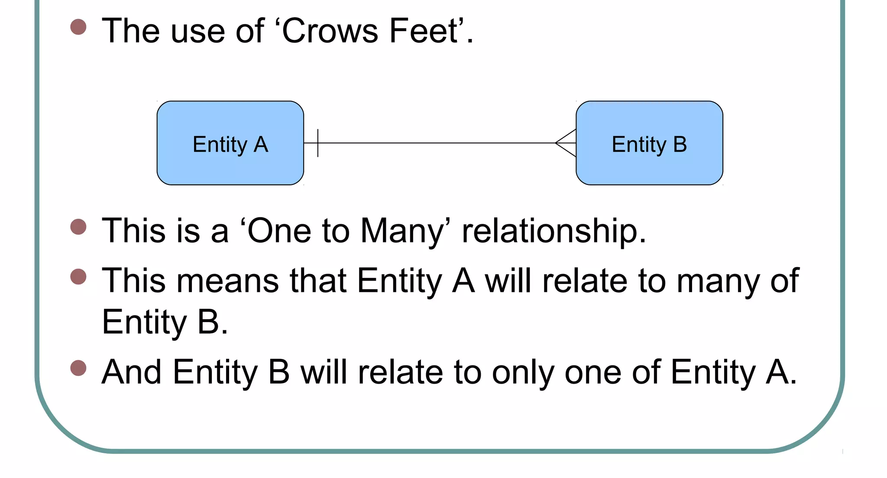
One-to-many Relationship

Slide 10
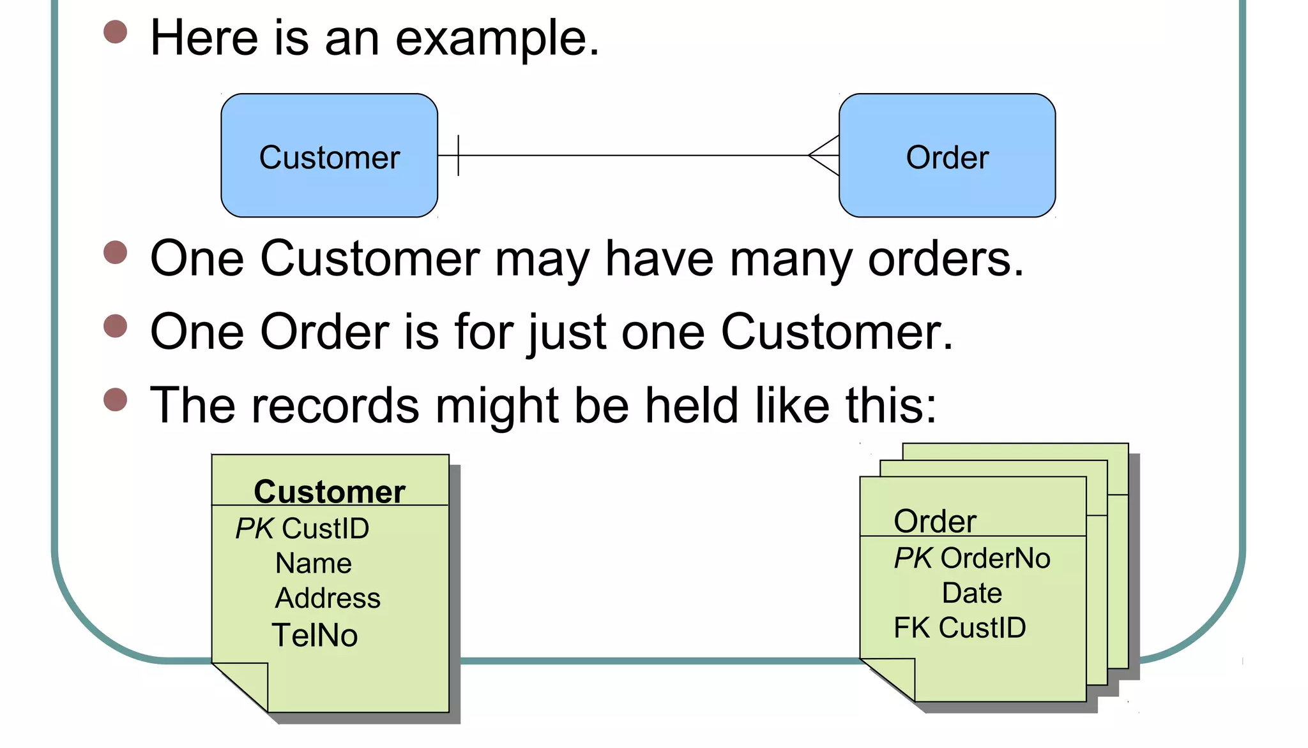
Example

Slide 11
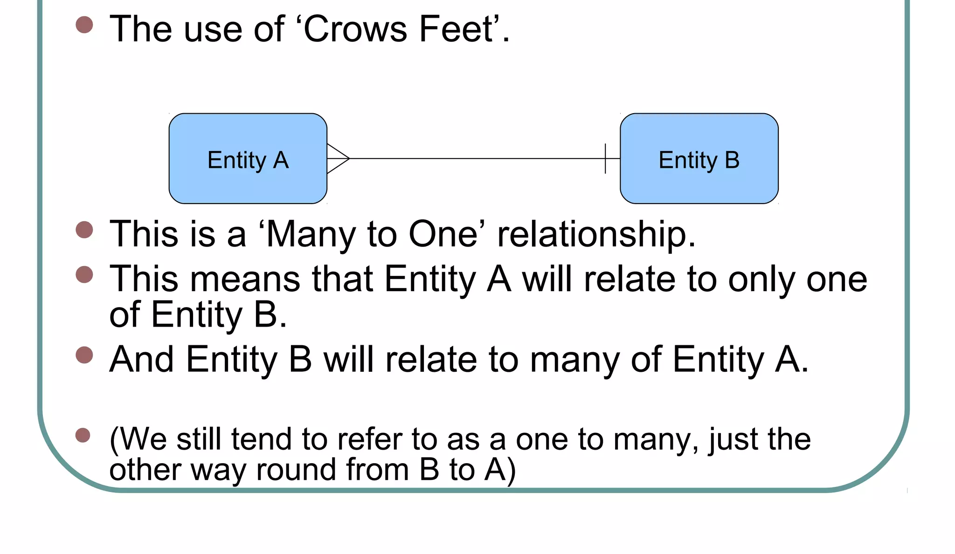
Many-to-one Relationship

Slide 12
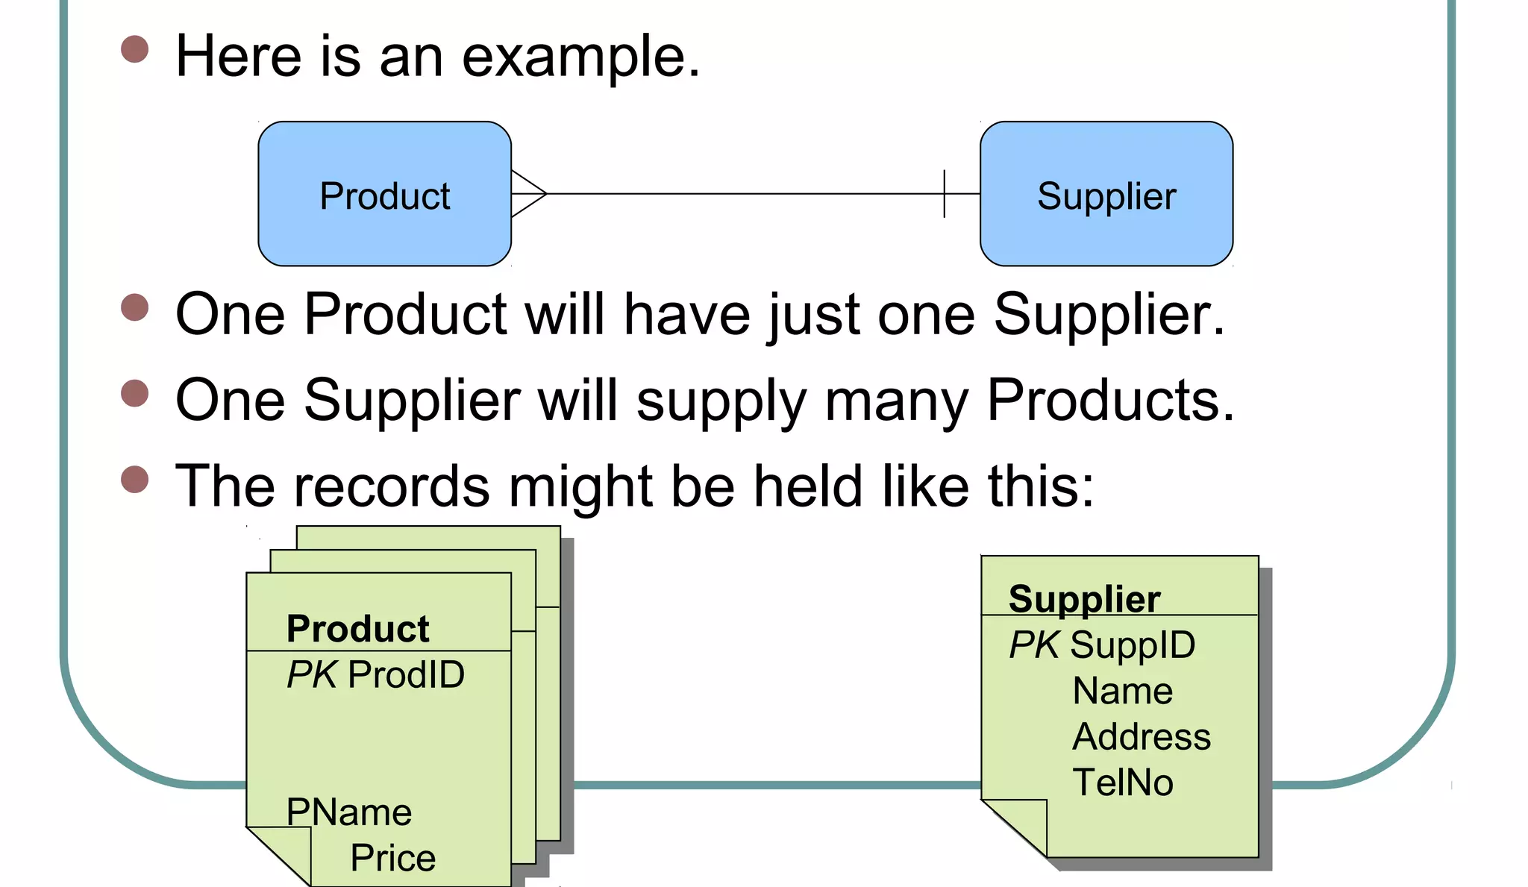
Example

Slide 13
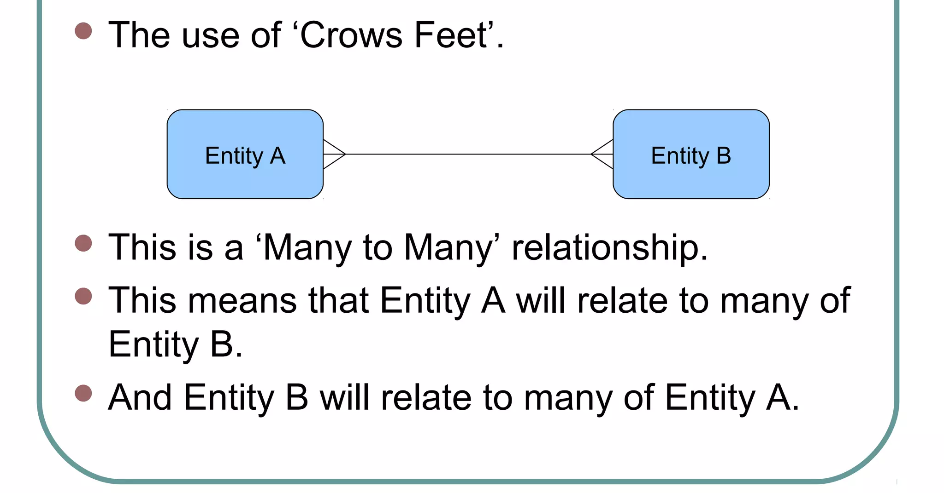
Many-to-Many Relationship

Slide 14
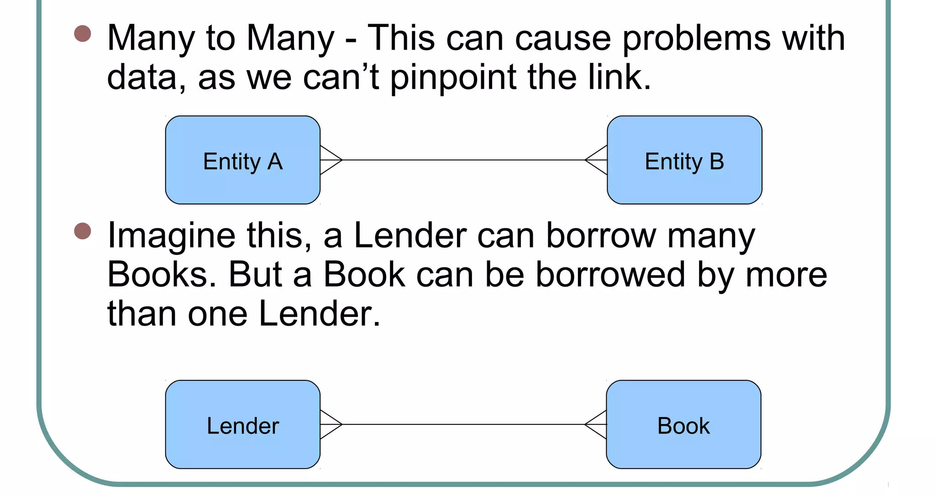
Cont...

Slide 15
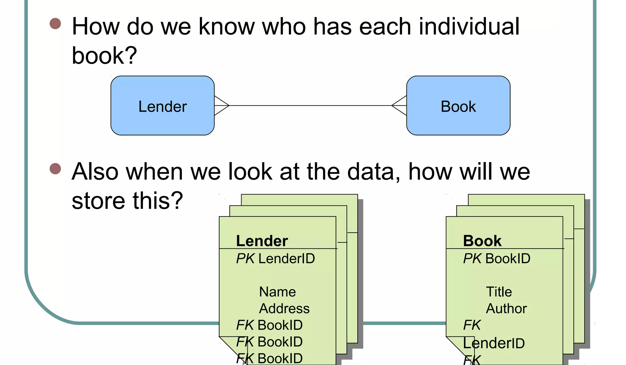

Slide 16
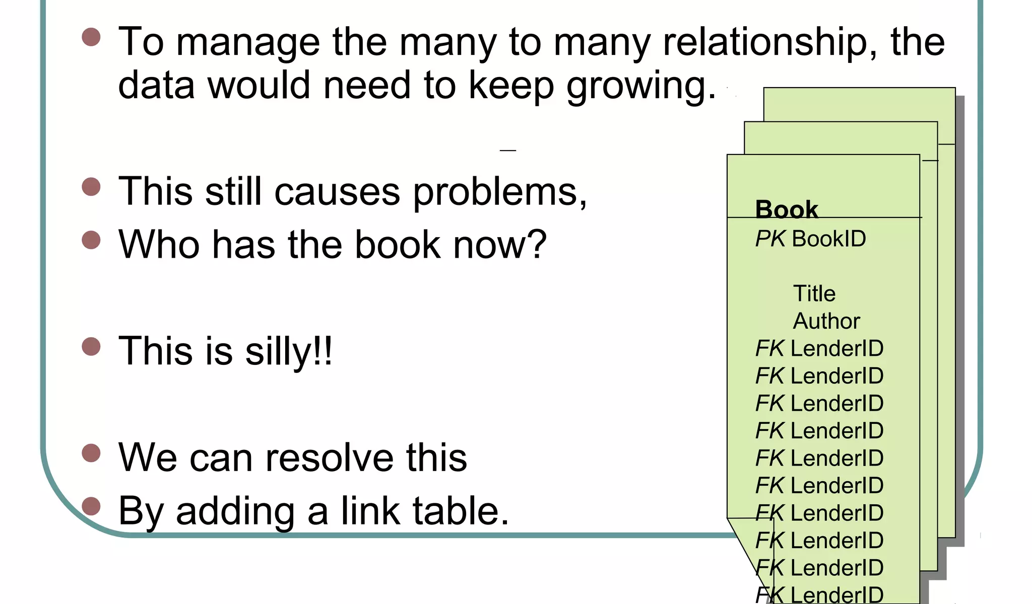

Slide 17
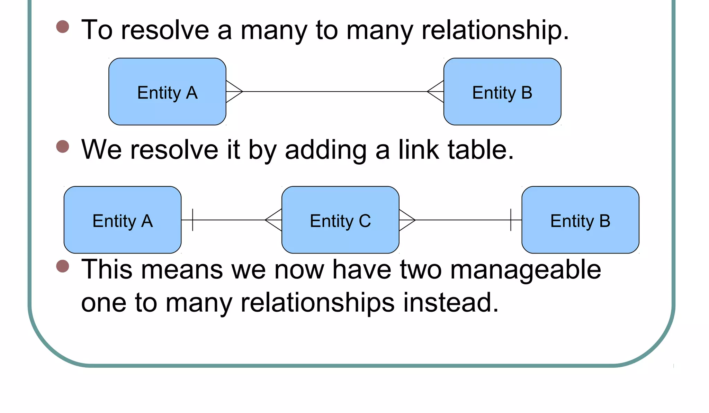

Slide 18
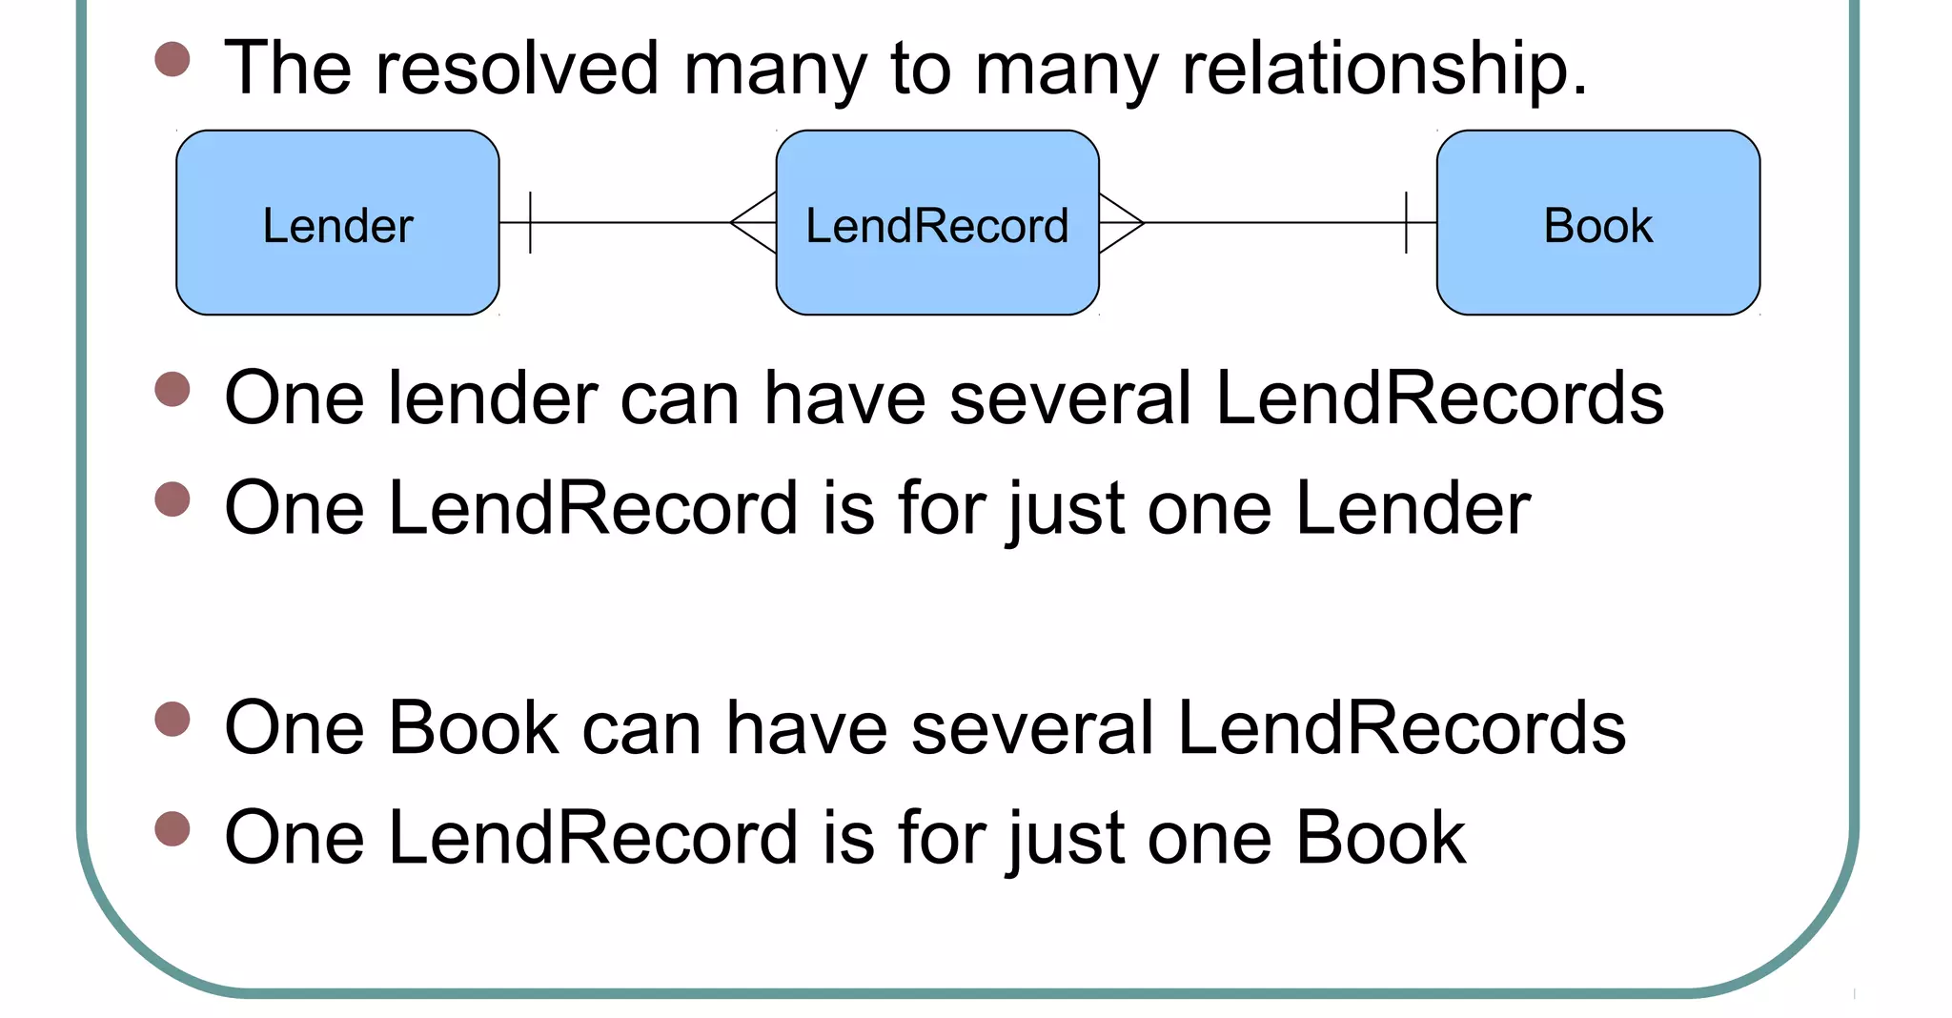

Slide 19
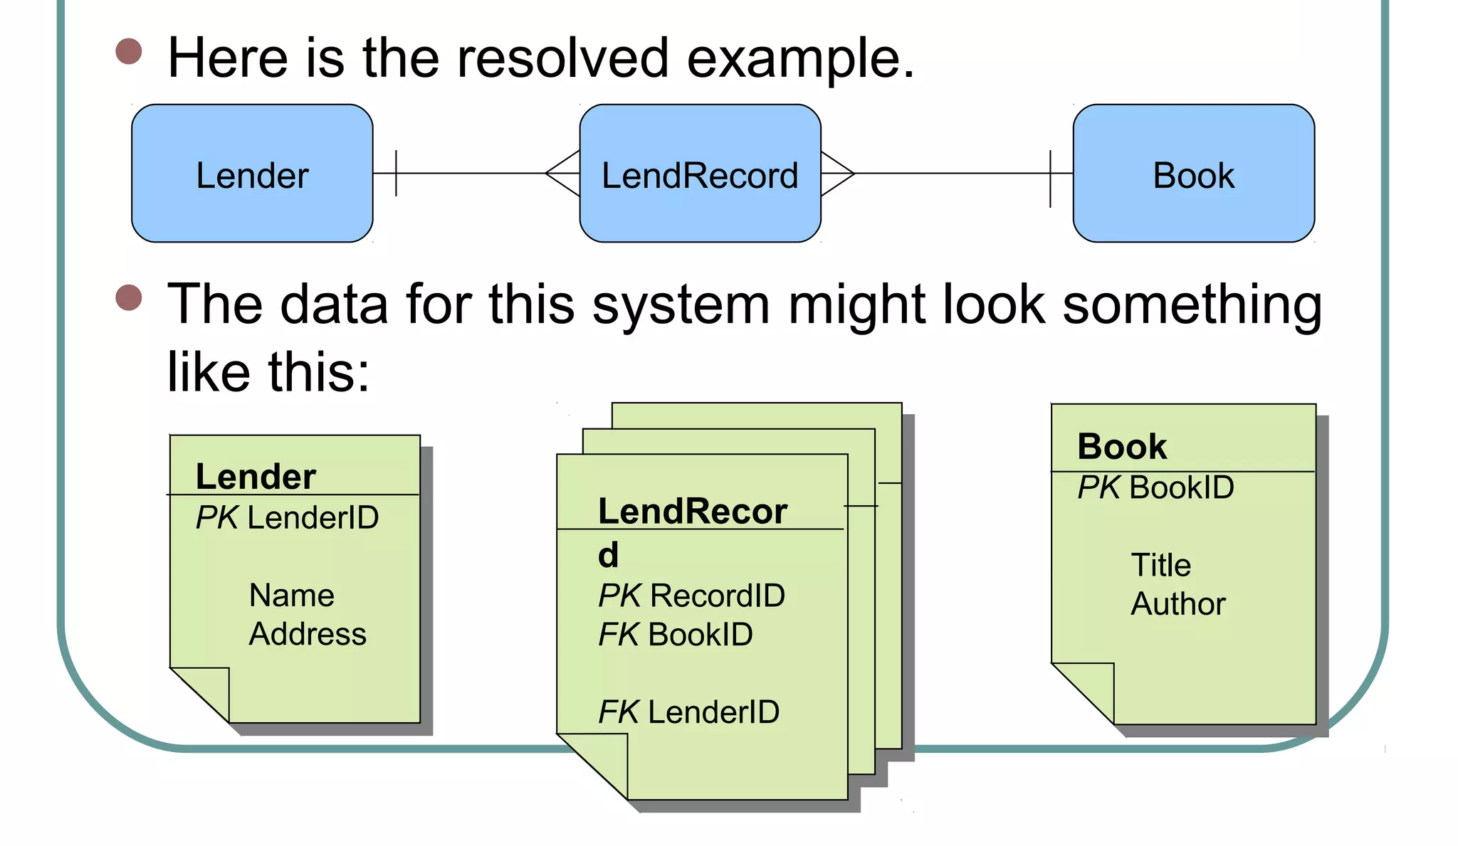

Slide 20
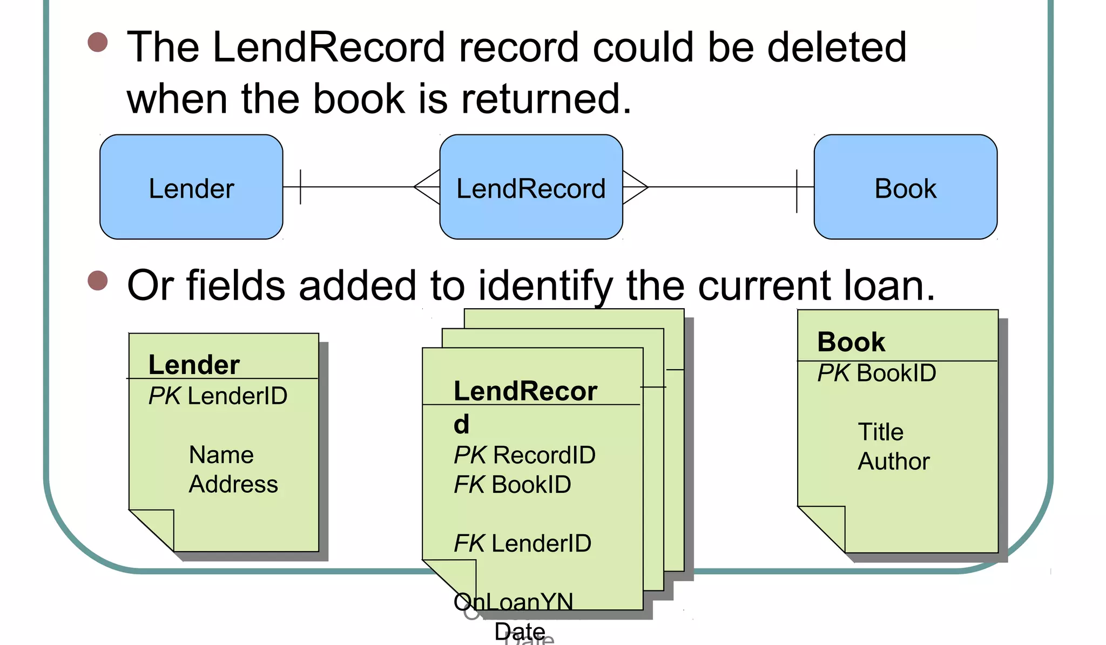

Slide 21
Class activity
Let’s study them with an Entity Relationship Diagram Example:
In a university, a Student enrolls in Courses. A student must be assigned to at least one or more Courses. Each course is taught by a single Professor. To maintain instruction quality, a Professor can deliver only one course

Slide 22
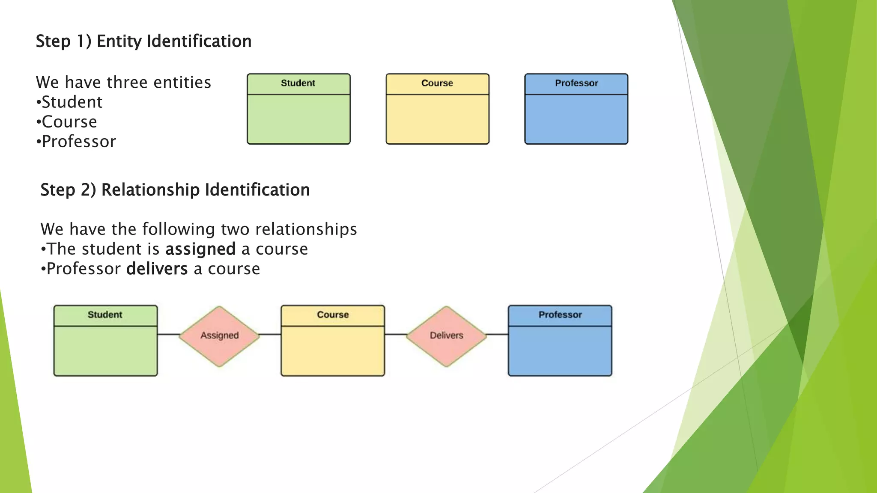

Slide 23
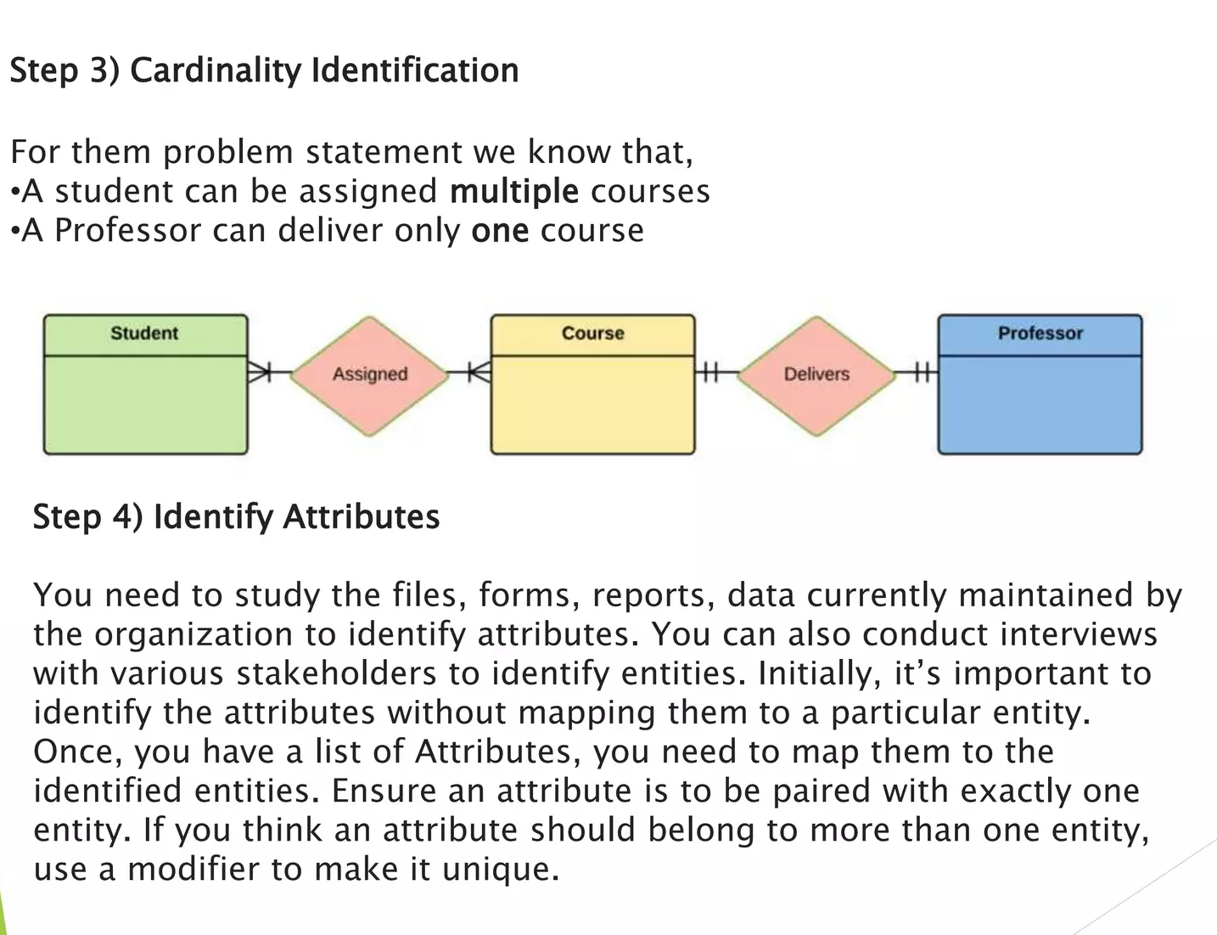

Slide 24
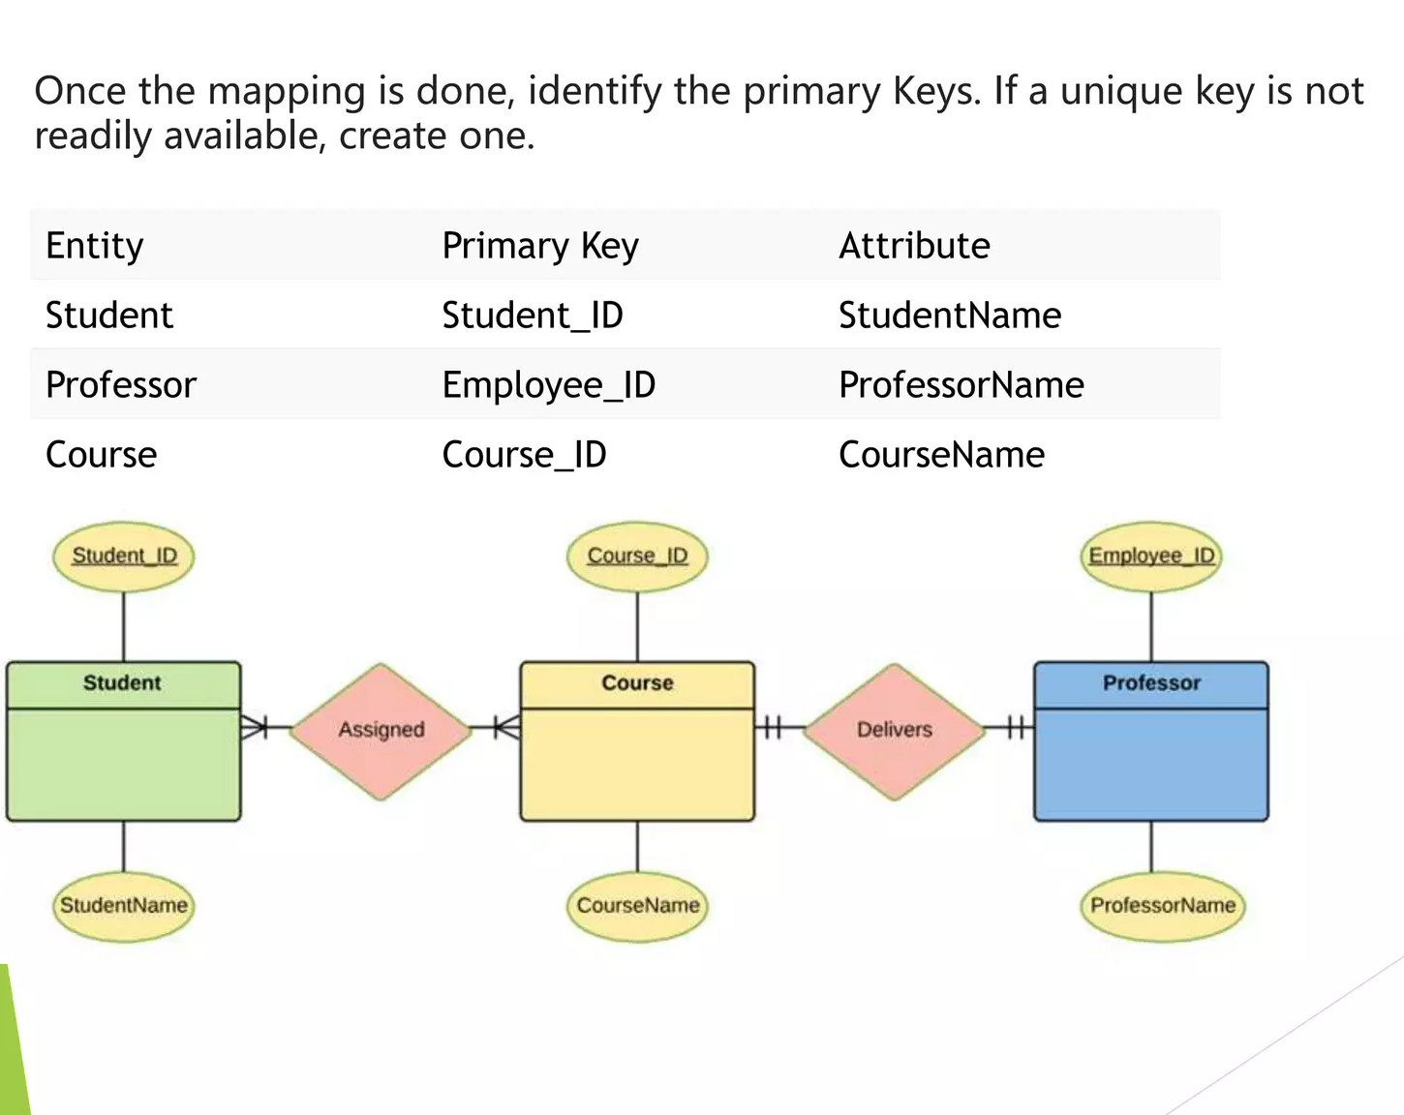

Slide 25
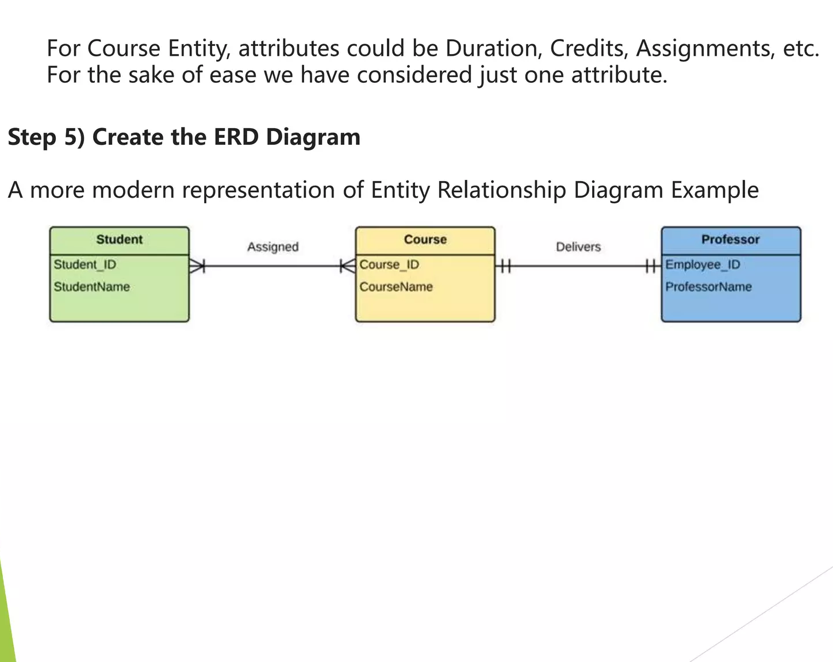

Slide 26
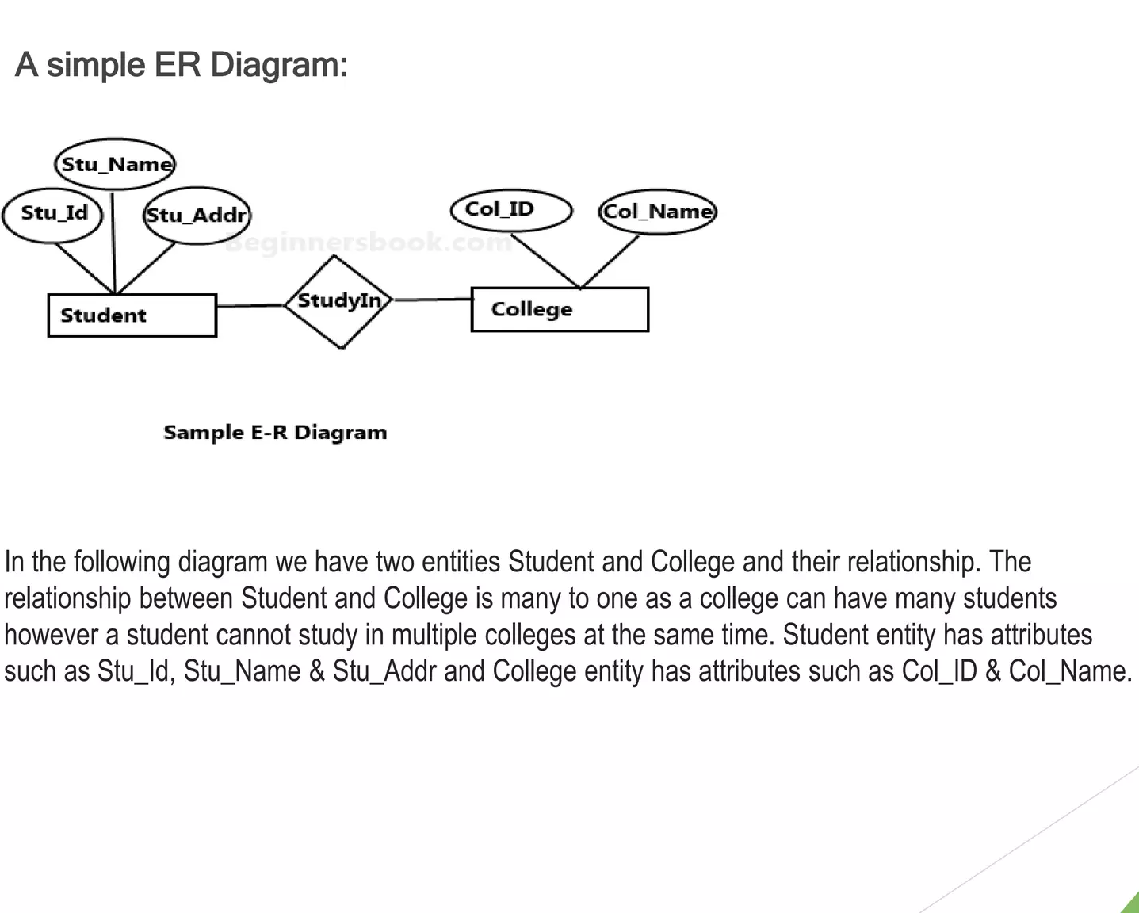

Slide 27
Existence Dependence (Recap)
An entity can exist only when it is associated with another related entity occurrence.
- Example: EMPLOYEE claims DEPENDENT
Entity type:
Strong entity or regular entity
Weak entity

Slide 28
Relationship Strength (Recap)
Based on how the primary key of a related entity is defined.
To implement a relationship, the primary key of one entity appears as a foreign key in the related entity.
Weak relationship
Strong relationship

Slide 29
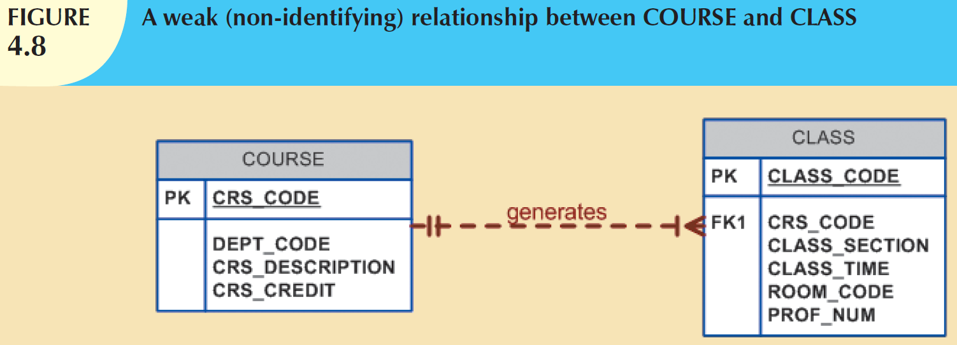
Weak (Non-identifying) Relationships
If the PK of the related entity does not contain a PK component of the parent entity.

Slide 30
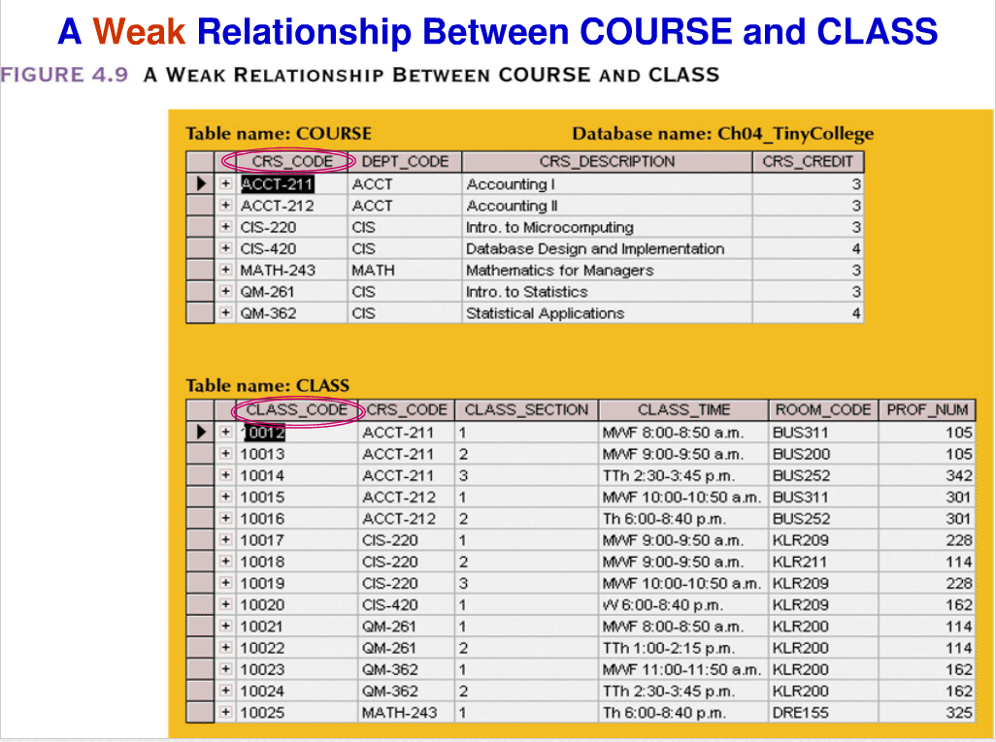

Slide 31
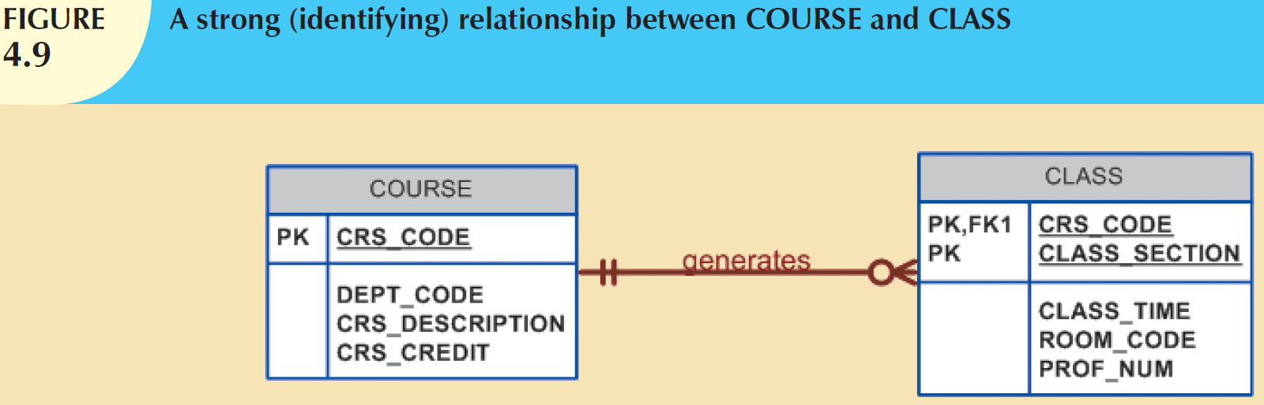
Strong (Identifying) Relationships
The PK of the related entity contains a PK component of the parent entity.

Slide 32
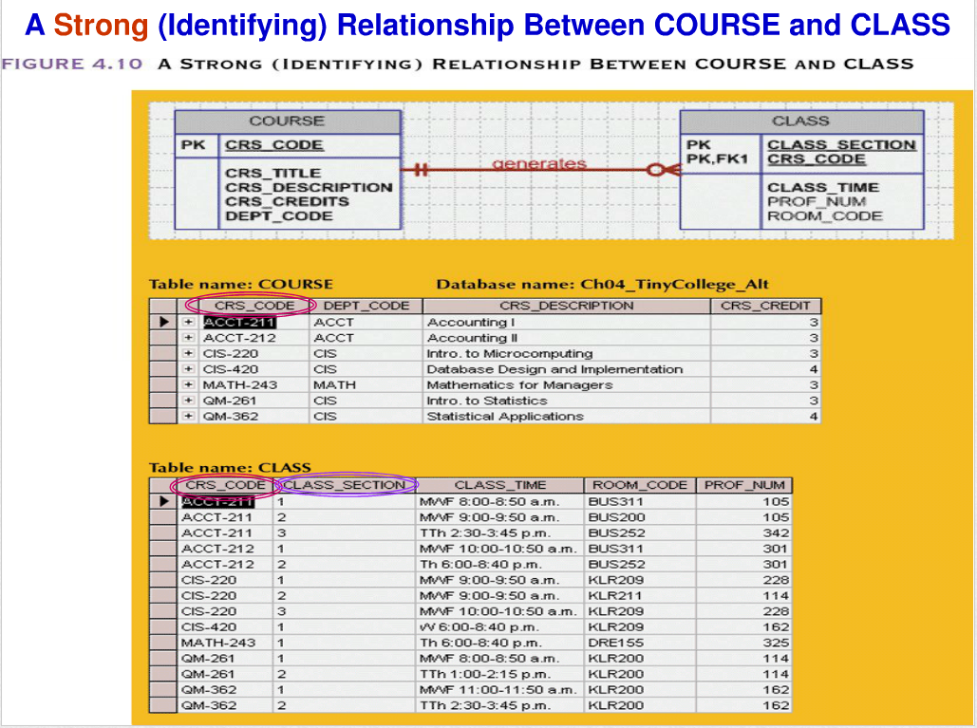

Slide 33
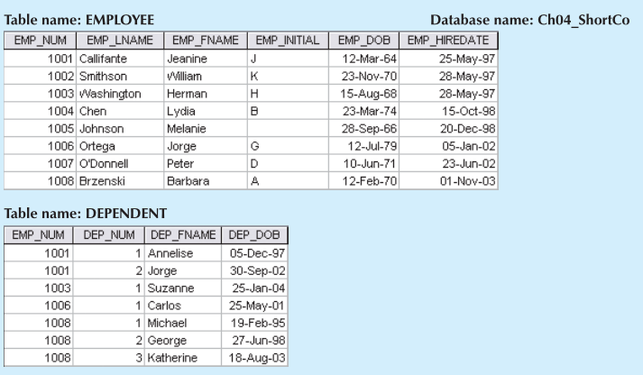
Weak entities
A weak entity is one that meets two conditions:
1. The entity is existence-dependent; that is, it cannot exist without the entity with which it has a relationship.
2. The entity has a primary key that is partially or totally derived from the parent entity in the relationship.

Slide 34
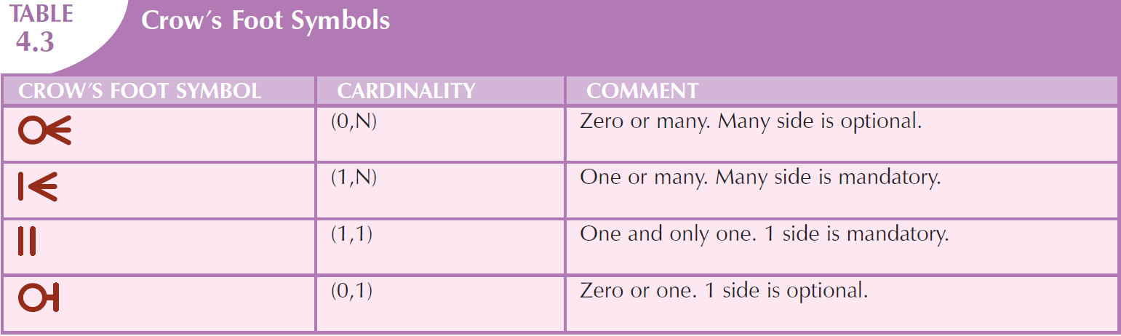
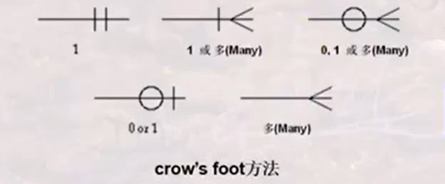

Slide 35
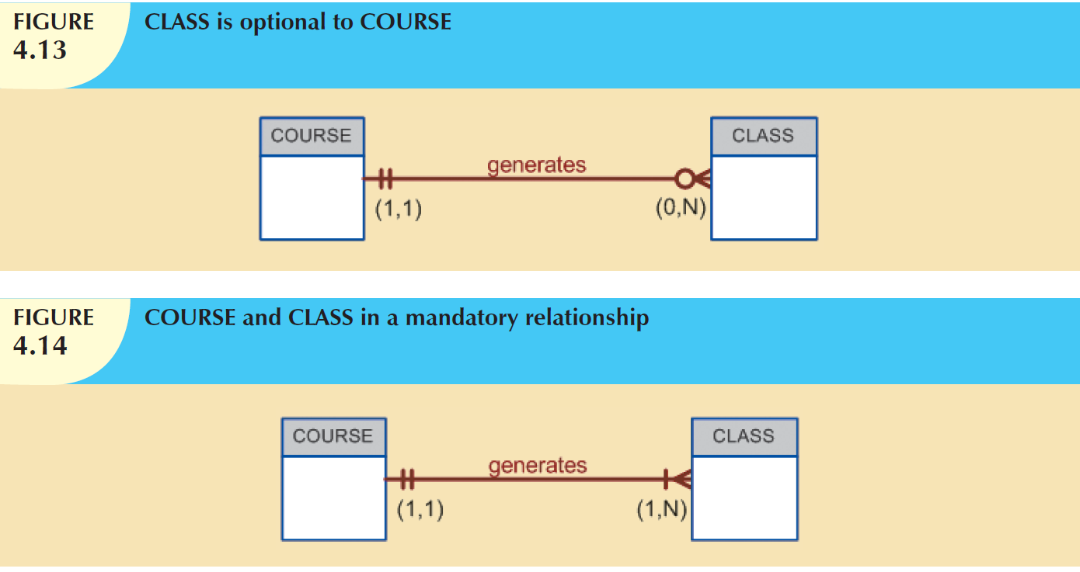

Slide 36
Summary on symbols used in E-R Notation

Slide 37
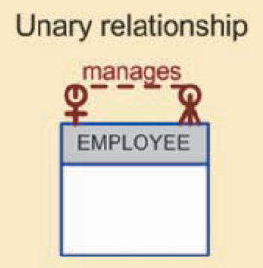
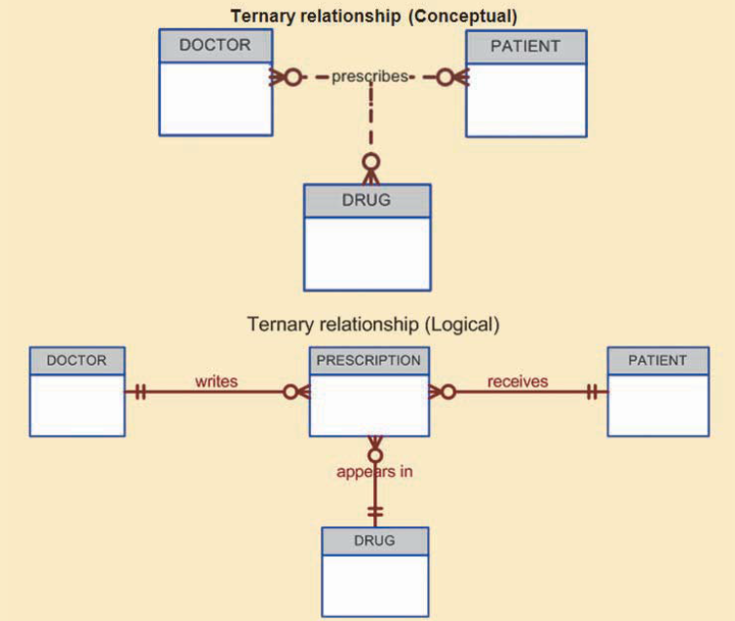
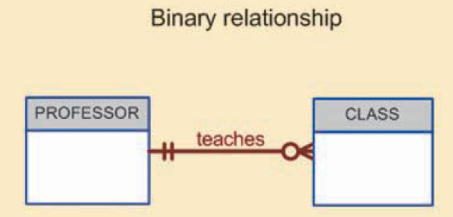
Relationship Degree
Unary
Binary
Ternary
Higher-Degree Relationship

Slide 38
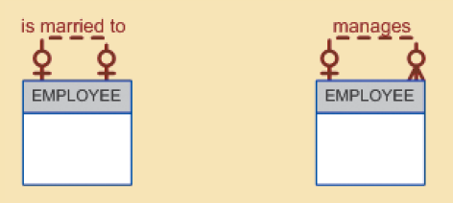
Recursive Relationship
A relationship can exist between occurrences of the same entity set.

Slide 39
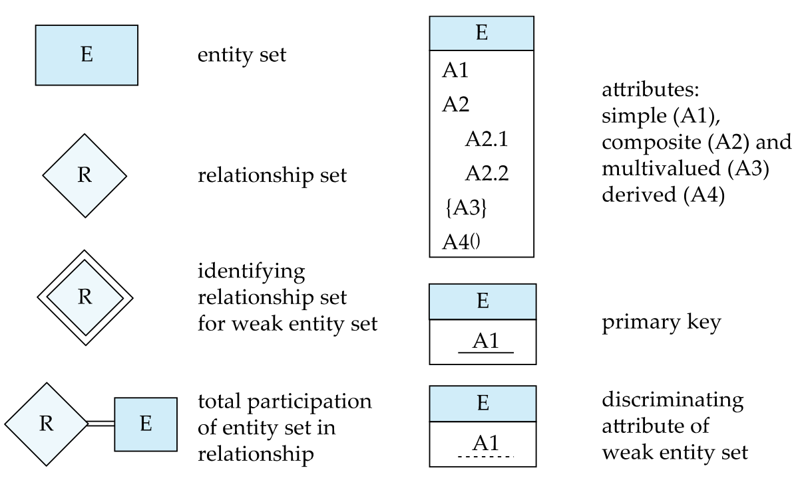
Summary of Symbols Used in E-R Notation

Slide 40
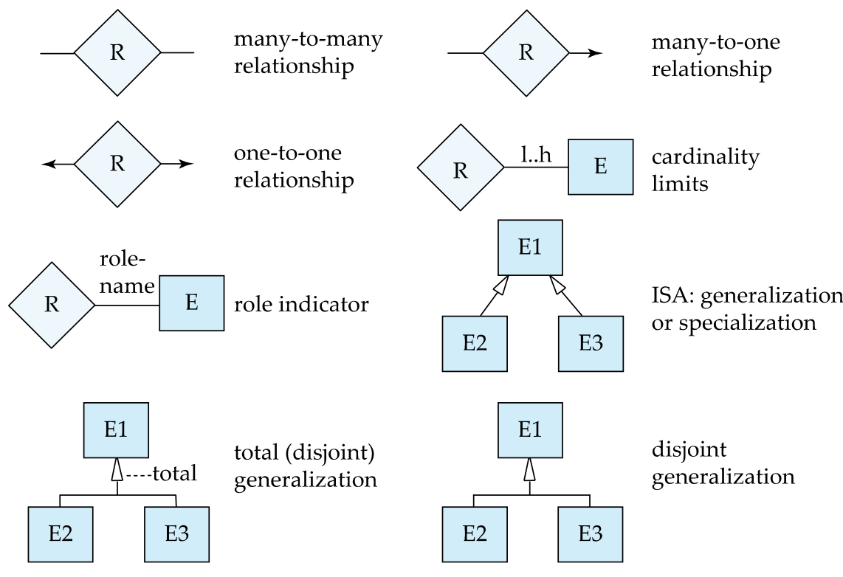
Symbols Used in E-R Notation (Cont.)

Slide 41
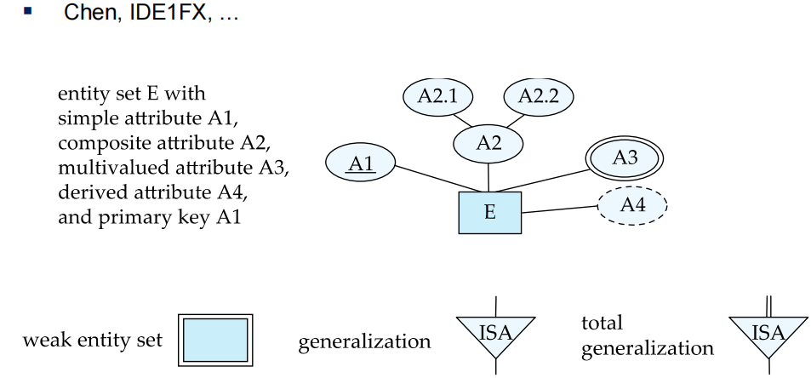
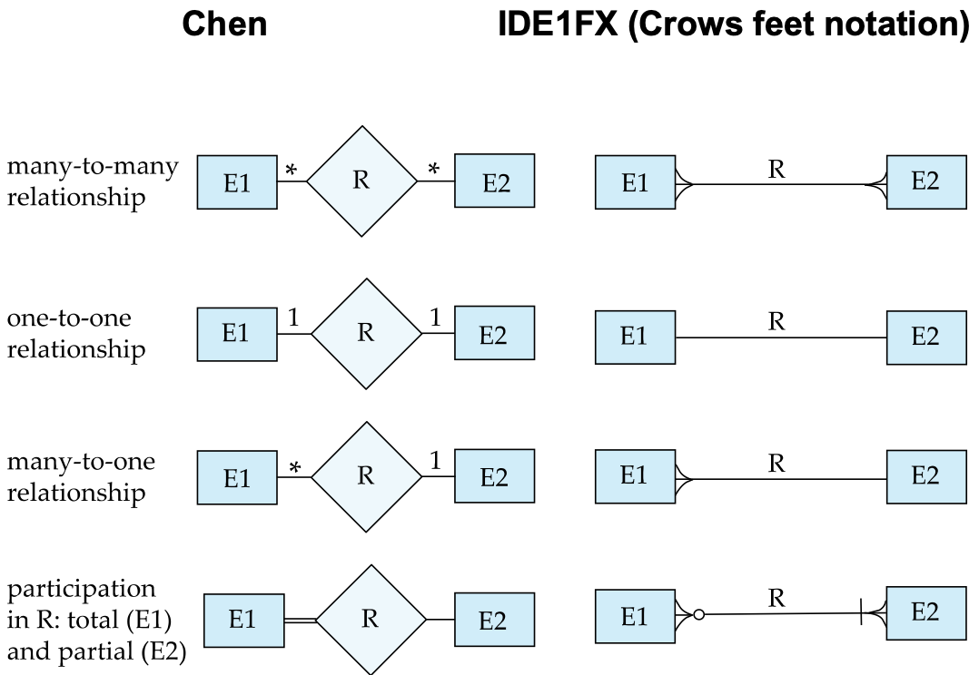
Alternative ER Notations

Slide 42
UML
UML: Unified Modeling Language
UML has many components to graphically model different aspects of an entire software system
UML Class Diagrams correspond to E-R Diagram, but several differences.

Slide 43
UML Class Diagrams (Cont.)
Binary relationship sets are represented in UML by just drawing a line connecting the entity sets. The relationship set name is written adjacent to the line.
The role played by an entity set in a relationship set may also be specified by writing the role name on the line, adjacent to the entity set.
The relationship set name may alternatively be written in a box, along with attributes of the relationship set, and the box is connected, using a dotted line, to the line depicting the relationship set.

Slide 44
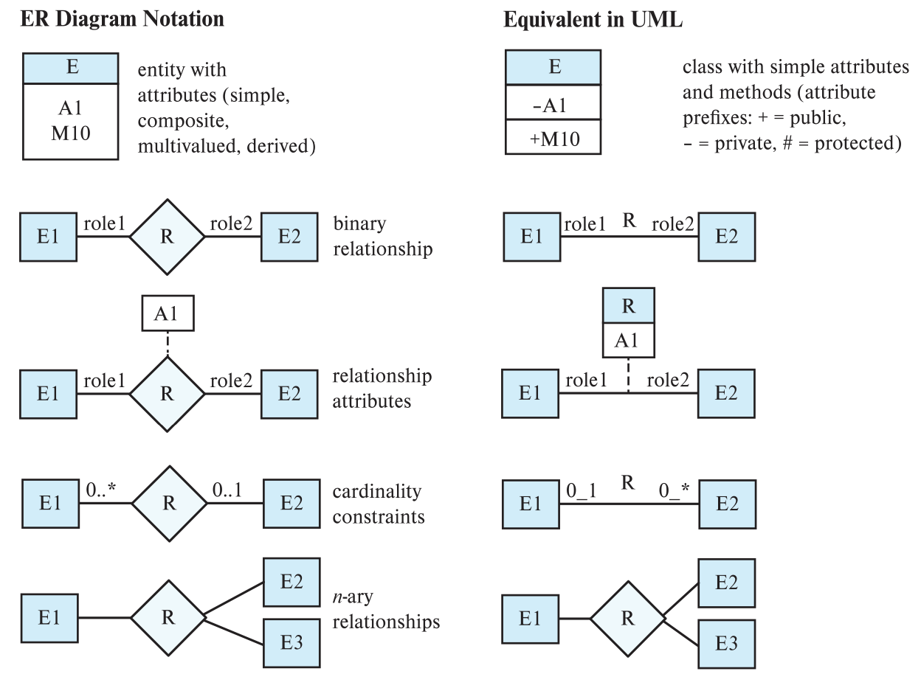
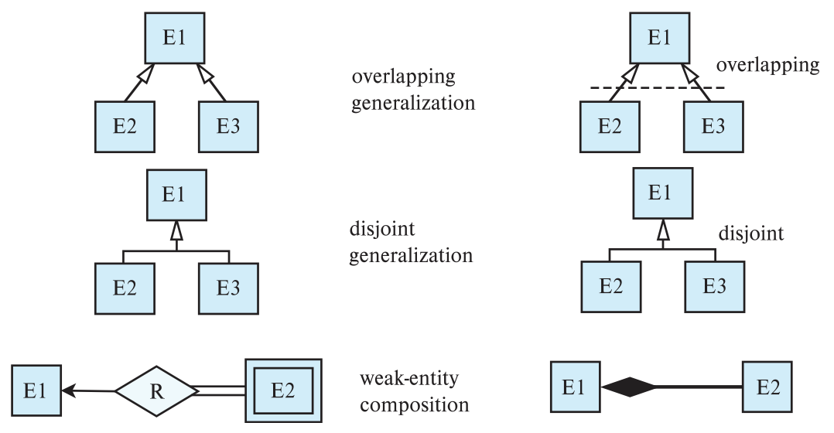
ER vs. UML Class Diagrams

Slide 45
End of Chapter 2

